Slide 1
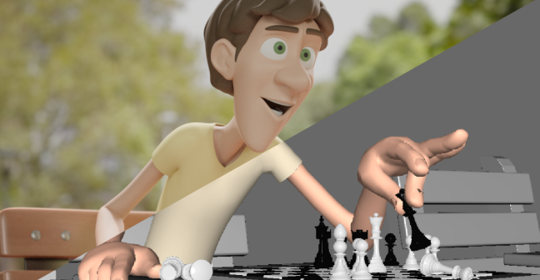
Workshop 2 CHALLENGE

Slide 2

Bonus Task
Using the same character model/s, in a new Blender scene animate the character performing a different action.
Try and use as many of the 12 principles of animation as you can. If you’re not sure what these are, check the Introduction to Animation content.

Slide 3
Animation Challenges
Pick one of the following…
If you modeled the boat in the previous challenge, animate the character fishing off of the boat
Animate two characters playing an intense game of rock/paper/ scissors. This can be a looping animation.
Animate a character dancing. The character can move around or be stationary.

Slide 4

Animation Challenges - Continued
Please make sure you SAVE your work. The next challenge powerpoint will be using the progress you’ve made here.

